Slide 1


Bank Customer Churn Prediction
Predict whether a bank customer will leave the bank (churn) using ML
by Omer Salem

Slide 2

The problem
The bank was experiencing customer churn — clients were quietly closing their accounts. Churn not only causes revenue loss, but it's also more expensive to acquire new customers than retain existing ones. Management wanted to know:
“Can we predict which customers are likely to leave so we can intervene early?”

Slide 3
What we have in our data
We received a dataset of 10,000 customers with 14 columns. It included:
Demographics (Geography, Gender, Age)
Account activity (Balance, Tenure)
Bank product usage (Number of products, Credit card ownership)
A target column Exited (1 if the customer churned)

Slide 4
Data Preprocessing
1) Created Age Group: Age binned into groups for better generalization
2) Handled categorical variables:
Geography and AgeGroup: LabelEncoded for model input
Gender: Binary encoding (Male = 1, Female = 0)
3) Scaled numerical features:
CreditScore, Balance, EstimatedSalary: Scaled with StandardScaler

Slide 5
Obstacles & Challenges:
1) What went wrong:
Unbalanced target class made it harder to detect churn
Initial encoding methods caused data leakage or incorrect model behavior
Model overfitting on training data (high train accuracy, low test accuracy)
2) How you solved them:
Ensured proper label encoding with consistent mappings
Tuned hyperparameters
Used scaled inputs and excluded unimportant features
We used the SMOTE to handle the unbalanced data, but it didn’t improve the accuracy

Slide 6
Model Performance
 | Acc_Train | Pre_Train | Rec_Train | F1_Train | Acc_Test | pre_Test | Rec_Test | F1_Test
Logistic Regression | 0.812750 | 0.787642 | 0.812750 | 0.769790 | 0.8200 | 0.793584 | 0.8200 | 0.778906
KNN | 0.839500 | 0.839710 | 0.839500 | 0.804743 | 0.8340 | 0.825862 | 0.8340 | 0.793783
SVM | 0.834750 | 0.842291 | 0.834750 | 0.793125 | 0.8395 | 0.846321 | 0.8395 | 0.797060
Decision Tree | 0.995375 | 0.995370 | 0.995375 | 0.995371 | 0.7920 | 0.795219 | 0.7920 | 0.793554
Random Forest | 0.999500 | 0.999500 | 0.999500 | 0.999500 | 0.8630 | 0.852774 | 0.8630 | 0.850794
Naive Bayes | 0.830000 | 0.819951 | 0.830000 | 0.793931 | 0.8300 | 0.812097 | 0.8300 | 0.793907
XGBoost | 0.924375 | 0.925008 | 0.924375 | 0.919710 | 0.8615 | 0.851029 | 0.8615 | 0.850997
AdaBoost | 0.850625 | 0.839558 | 0.850625 | 0.833975 | 0.8525 | 0.839630 | 0.8525 | 0.838517
Gradient Boosting | 0.868375 | 0.863234 | 0.868375 | 0.853647 | 0.8620 | 0.852236 | 0.8620 | 0.846915
CatBoost | 0.886000 | 0.883406 | 0.886000 | 0.875449 | 0.8700 | 0.861976 | 0.8700 | 0.857133
LightGBM | 0.885750 | 0.882309 | 0.885750 | 0.875878 | 0.8675 | 0.858443 | 0.8675 | 0.855374

Slide 7
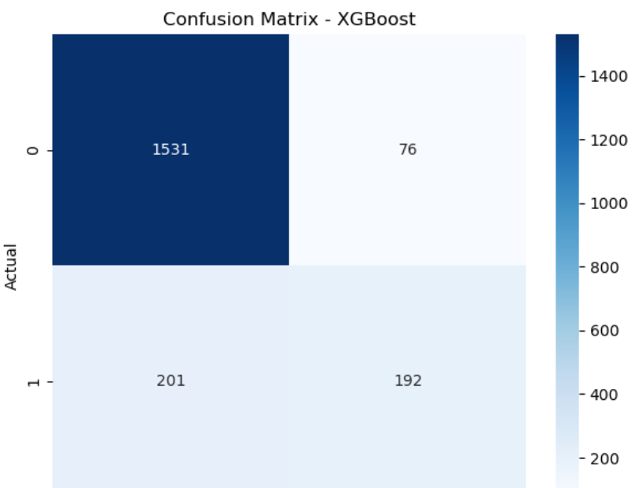
Some of the models
Model Used: XGBoost
Performance Metrics:
Accuracy: 0.86%
Precision/Recall/F1-score: 0.85% / 0.86% / 0.85%

Slide 8
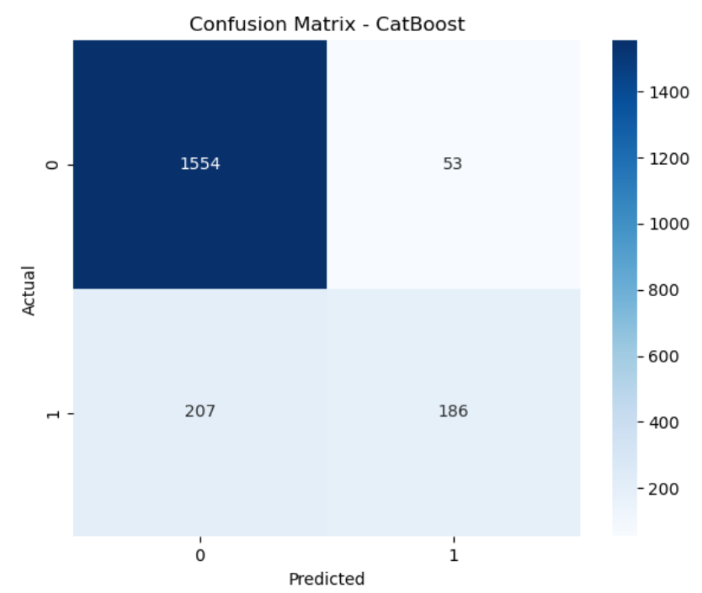
Some of the models
Model Used: CatBoost
Performance Metrics:
Accuracy: 0.87%
Precision/Recall/F1-score: 0.86% / 0.87% / 0.85%

Slide 9
Future Work
1) What can be improved:
Add new features like transaction history, product usage, or customer satisfaction score
Try to apply Neural Networks
2) Deployment Ideas:
Add batch prediction or file upload support
Add customer retention strategies based on model output

Slide 10
Thank you 🥸

